Slide 1

UPLIZNA Feedback Analysis (June 2024)
July 23, 2024
This presentation is provided to you by Trinity, LLC. The presentation is meant to enhance discussions between your organization and Trinity, LLC. The substance of this presentation is confidential and may be legally privileged. This presentation is intended only for those in attendance.

Slide 2
Agenda Slides
User Feedback Summary
Issues Resolved with Latest Architecture
Areas of Further Refinement
Feedback: Need More Clarity

Slide 3

Feedbacks from UPLIZNA BU [21 user comments]
Negative
Neutral
Positive
Constructive
This response was accurate and relevant; however the response only consisted of lower limit of normal levels within our N-MOmentum trial, and not other sources clinicians and HCPs will be using to evaluate LLN for B cell levels
This response addresses the use of steroids in this disease rather than in the N-MOmentum trial. I don't love the question becasue I don't know if it is asking about use of steroids for acute attacks, or if it is referring to standard concomitant use/the taper given during the first several weeks of the trial. Assuming both, these are both outlined in bot hte study protocol and in the Lancet 2019.
While this response gave context to how attacks were defined in the PREVENT study and also gave context into their adjudication process, the response would have been more complete if it included number of attacks identified by investigators versus how many of those attacks were accepted and/or rejected by the adjudication committee for PREVENT.
This answer was not comprehensive and did not completely identify overlapping autoimmune disorders with NMOSD. Answer is very basic, and did not provide the epidemiology, prevalence, or incidence of coexisting disorders.
1. Does not focus on the major differences between the 3 therapies 2. Does not include Ultomiris (Ravulizumab) amongst the novel FDA approved therapies 3. Inaccurate information - Inebilizumab does NOT allow for self-administration. 4. Inaccurate/Misleading information - Satralizumab does have a considerable cost of treatment but is amongst the cheapest of all FDA approved options, so it is misleading.
Could be more comprehensive to include change in plasma cell levels in N-MOmentum trial cohort during the RCP and OLE. Could also note the importance of plasma cells in long term immunization memory, and reference the data of childhood vaccinations and how they were maintained despite use of inebilizumab depletion.
This answer was no where near accurate and was not even up-to-date on current therapies for NMOSD. Also, the answer had nothing to do with immune reconstitution in NMOSD.
It is accurate... but in no way answers the question asked. (Interestingly, some of this data was missing from another of my questions, where it was needed.) Figure 1 in the EoS manuscript addresses this question (Cree 2024 Lancet Neurol)
This answer completely missed the boat on providing any details about the risk of infection with low Ig while Uplizna is used. Data missing includes the Greenberg presentation from 2021 and the Cree end of study publication. This one was really inaccurate.
This response seems to somewhat answer the question, but tangentally goes into low immunoglobulins. The infections cited from N-MOmentum are correct, but this answer also appears to be missing data from the Cree end of study results.
More detail about the attack criteria would be helpful, i.e., how many of the criteria addressed each domain within the CNS. We were the only study that utilized MRI for a subset of attacks, and the importance of utilization of MRI should be highlighted -- the fact that it was only used for more subtle presentations of the disease, i.e., brain/brainstem attacks and more subtle attacks that could be localized to the optic nerves or cord. The study protocol would be helpful here. The appendix of Cree 2019 Lancet would help with this. Weinshenker 2023 attack adjudication paper, Attack adjudication in neuromyelitis optica spectrum disorder: Substantiation of criteria by magnetic resonance imaging and biomarkers in N-MOmentum. would be helpful as well.
While there isn't a single reference to answer this question, we were testing it to see if it would pull the data from slide decks or Standard Response letters that differentiate the CD19 B cell drug from CD20s. The comprehensive answer would include information about the glycoengineering of the product, the fact that its humanized, and that it targets CD19.
The last bullet- "Therefore, while the efficacy of UPLIZNA in MOG-positive disease remains uncertain, it has shown a consistent effect in reducing the risk of disability worsening in NMOSD patients" is not relevant. Would be nice if it acknowledge the number of MOG+ patients that were in the study it pulled this information on my next prompt specifically asking for this).
This response provided extensive information into the rationale behind having an adjudication committee and thorough adjudication criteria. Additionally, it gave a proper breakdown on the number of attacks and how many were confirmed by adjudication.
The new Osborne paper needs to be loaded: Osborne B, et al. Front Neurol. 2024 Apr 16;15:1352779. doi: 10.3389/fneur.2024.1352779. PMID: 38689876; PMCID: PMC11060151. https://pubmed.ncbi.nlm.nih.gov/38689876/ OPEN ACCESS
It provided a nice high level overview, but I was looking for specific numbers to further provide color to this answer. If I asked another question following "what was the pain reduction", it provided a more robust response that I found more helpful, however the OR and percentages would be nice to accompany this answer (which are included in the citiation).
While this response provided relevant factors to be considered, it did not account for patient preference or include anything about a shared decision making process.
While this provided great information on our post-hoc analysis, based on phenotype, I feel I learned more reading through the sources than the response itself
While accurate, this response is very 30k foot overview and sorely lacks comprehensiveness. One point regarding accuracy, however, is that this is summarizing the Phase 2/3 study,. One study. Not the Phase 2 and 3 studies. Regarding lack of robustness, lots of detail missing: first, this only delves into the RCP of the N-MOmentum study and does not address the full study at all, which includes the open-label extension period. This does not reference how long the RCP was, how participants were randomized, what happened if participants had an attack or were suspected of having had an attack, how attacks were evaluated, who was eligible for the trial, how many were seropositive versus seronegative, there are no longterm safety or efficacy outcomes mentioned... most of this information can be gotten from Cree, Lancet, 2019, and the rest from the most recent end of study manuscript, Cree, Lancet Neurology 2024.
Could be more comprehensive in including the rate of change in sNFL levels seen in inebilizumab treated patients
The ask was essentially why was CD 20 measured instead of CD 19, as it is counter intuitive to measure something else than what you are targeting depleting. The answer had some good points, however the answer we were looking for is more so that for CD19+ B-cell counts, assays for CD20+ B cells are used because the presence of UPLIZNA interferes with CD19+ B-cell assay. Found in product monograph (should be added) and in-Br J Clin Pharmacol. 2022 Aug; 88(8): 3803–3812. Published online 2022 Apr 5. doi: 10.1111/bcp.15332

Slide 4
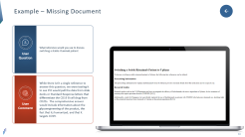
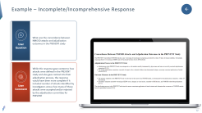




User Feedback Summary and Issue Identified
Incomplete/ Incomprehensive response | Incorrect/Irrelevant response | Missing Document
Response did not include all relevant points Responses lacked sufficient numerical information Response provided was too generic Relevant information present in the document was not retrieved | Response provided were inaccurate, misleading Response provided was not related tp the question | Information required out of the answer was not present in the knowledge base
Some issues have been resolved or partially resolved with the latest architecture in certain scenarios. However, in other scenarios, these issues still need to be addressed and resolved.

Slide 5
Agenda Slides
User Feedback Summary
Issues Resolved with Latest Architecture
Areas of Further Refinement
Feedback: Need More Clarity

Slide 6

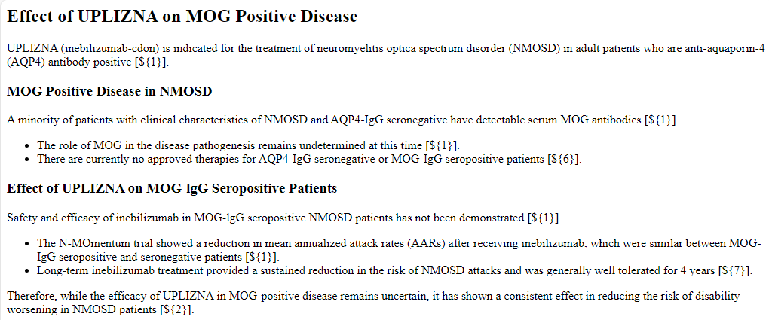
Issues Resolved with the latest architecture More comprehensive response and Irrelevant points are filtered out
User Prompt
What is UPLIZNA’s effect on MOG positive disease?
User Comment
The last bullet- "Therefore, while the efficacy of UPLIZNA in MOG-positive disease remains uncertain, it has shown a consistent effect in reducing the risk of disability worsening in NMOSD patients" is not relevant. Would be nice if it acknowledge the number of MOG+ patients that were in the study it pulled this information on my next prompt specifically asking for this).
Click Here for new response

Slide 7
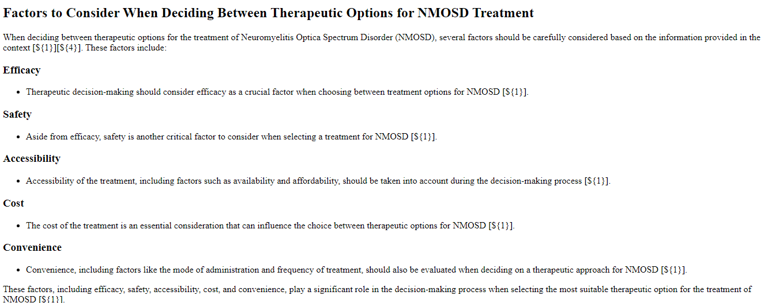
Partially Resolved
User Prompt
What factors should be considered when deciding between therapeutics options for the treatment of NMOSD?
User Comment
While this response provided relevant factors to be considered, it did not account for patient preference or include anything about a shared decision-making process.
Click Here for new response

Slide 8
Agenda Slides
User Feedback Summary
Issues Resolved with Latest Architecture
Areas of Further Refinement
Feedback: Needs More Clarity

Slide 9





Areas for Further Refinement In the latest architecture most of them have been addressed and resolved multiple scenarios but still some extreme scenarios need to be addressed
Prompt Engineering
Re-Ranking
Improve Table Parsing
Relevant numbers not included in response
Basic and less comprehensive response
Irrelevant data being included in the response
Relevant information from the table are not being shown in the initial prompt
Problem addressed
Prompt engineering could be tuned to include relevant numbers in the response. User prompt could be tuned to include more details expected out of the response
Re-ranking enhances the retrieval process by refining the set of retrieved items, ensuring that the most relevant ones are considered for the user prompt- Refining the Re-ranking technique would generate a better score for the chunks, enabling the most relevant ones to appear in the response
Analyse the textract-extracted table output
Analyse the semantic chunking of the extract. Necessary fixes can be applied based on these analysis
Approach

Slide 10
Agenda Slides
User Feedback Summary
Issues resolved with latest Architecture
Areas of Further Refinement
Feedback: Need More Clarity

Slide 11
Appendix

Slide 12

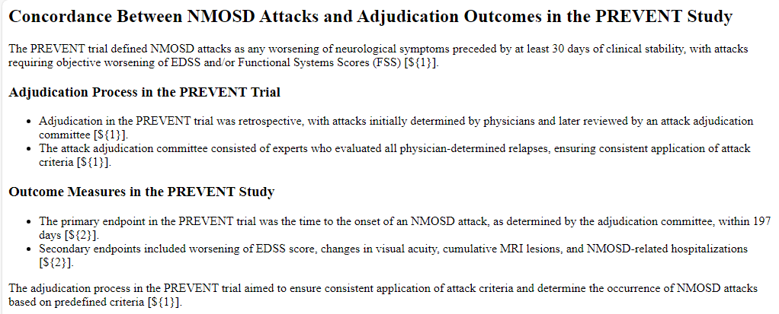

Example – Incomplete/Incomprehensive Response
←
User Question
What was the concordance between NMOSD attacks and adjudication outcomes in the PREVENT study
User Comment
While this response gave context to how attacks were defined in the PREVENT study and also gave context into their adjudication process, the response would have been more complete if it included number of attacks identified by investigators versus how many of those attacks were accepted and/or rejected by the adjudication committee for PREVENT

Slide 13
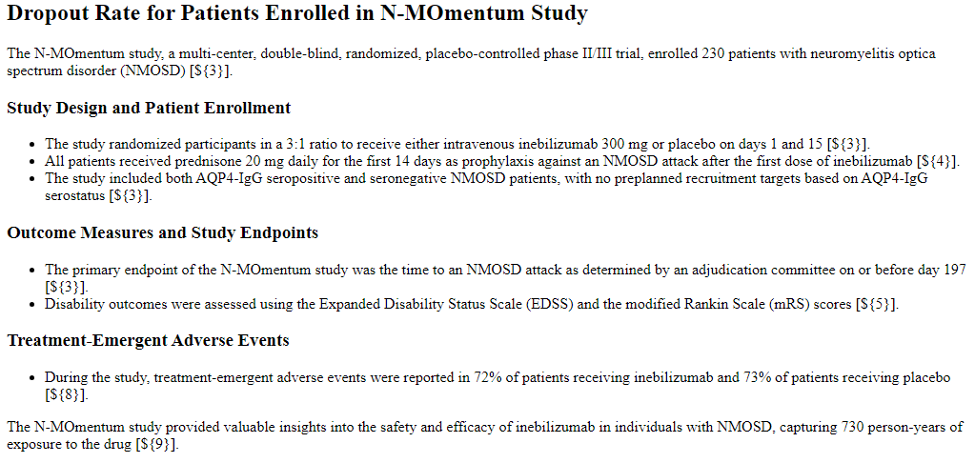
Example – Incorrect Response
←
User Question
What is the drop-out rate for patients enrolled in the N-Momentum study?
User Comment
It is accurate... but in no way answers the question asked. (Interestingly, some of this data was missing from another of my questions, where it was needed.) Figure 1 in the EoS manuscript addresses this question (Cree 2024 Lancet Neurol)

Slide 14
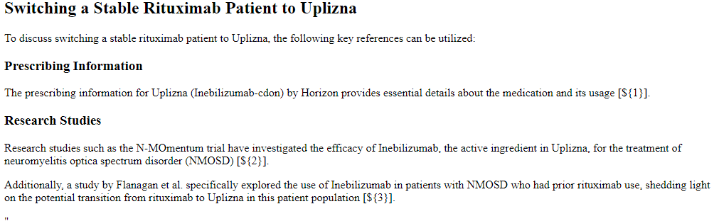
Example – Missing Document
←
User Question
What reference would you use to discuss switching a stable rituximab patient
User Comment
While there isn't a single reference to answer this question, we were testing it to see if it would pull the data from slide decks or Standard Response letters that differentiate the CD19 B cell drug from CD20s. The comprehensive answer would include information about the glycoengineering of the product, the fact that its humanized, and that it targets CD19.

Slide 15
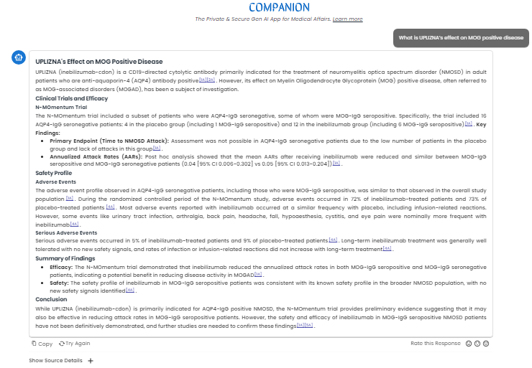
←

Slide 16



